Slide 1
Advanced AB testing in practice
By: Eltsefon Mark

Slide 2
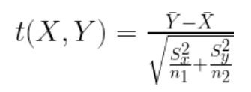
T test?
Assumptions:
Variances of groups should be equal
Means should be normally distributed
Groups should be independent

Slide 3
T test? When it does not work?
Ratio metrics
Quantiles
Proportions
Severe skewness of the metric

Slide 4

T test? Ratio metrics
Examples:
Average session length
CTR
Problems:
X and Y are dependant
Variance of such complex metric

Slide 5
T test? Ratio metric. Just use average
1.25$
0
0$
0.5$
1.5$
1$
2.5$

Slide 6


T test? Ratio metric. Just use average
1.25$
0
0$
0.5$
1.5$
1$
2.5$

Slide 7
T test? Methods
Bootstrap
Bucketization
Delta method

